Slide 1

Anvexa
Connected by Intelligence.
Investor Pitch & Business Proposal
Pune, Maharashtra · Founded 2023 · Prepared by the Anvexa Founding Team

Slide 2
Our Mission
To empower medium and large enterprises with secure, scalable, and intelligent technology solutions that accelerate digital transformation, enhance operational efficiency, and drive sustainable business growth.
Client-First Obsession
Radical Transparency
Relentless Execution
Continuous Innovation
Anvexa · Investor Pitch
2

Slide 3
Our Vision
To become India’s most trusted technology transformation partner for the mid-market economy by 2030.
63M+
~30%
$85B
SMEs in India needing affordable technology
of India’s GDP comes from SMEs
projected SME digital spend by 2028
Anvexa · Investor Pitch
3

Slide 4
Summary
Who we are
Market opportunity
Our solution
Pune-based B2B technology company founded in 2023, integrating AI, cloud and business systems.
63M+ SMEs rely on manual, insecure tools. SME digital spend will reach $85B by 2028 (TAM ₹65,000 Cr).
One connected platform: dashboard, easy cloud migration, built-in cybersecurity and AI periodic reports.
Growth
Business model
The ask
45+ projects, 32 recurring clients, ₹6.20 Cr three-year revenue, 58% gross margin, profitable every year.
Usage-based, pay-as-you-grow subscription with predictable recurring revenue.
₹2 Cr for 16.67% equity at ₹12 Cr post-money, to strengthen AI, Cloud, Cybersecurity and Quantum readiness.
Anvexa · Investor Pitch
4

Slide 5
Company Background
Founded in Pune in 2023, Anvexa grew from one observation across two sectors: retail distributors reconciling stock on paper ledgers, and IT services firms with fragmented project tracking and legacy infrastructure. Enterprise platforms were too costly and complex, while basic tools lacked security and scale. The team pooled their savings to build one unified, affordable platform.
Anish
Kaustubh
CEO & Co-Founder
Head of Business Development
Piyush
Gracy
Chief Marketing Officer
Chief Product Officer
Ruth
Riyaz
Client-First · Transparent · Relentless Execution · Continuous Innovation
Chief Technology Officer
Solutions Architect & Cloud Strategy Lead
Nishant
Janhvi
Chief Financial Officer
Director, Investor Relations
Anvexa · Investor Pitch
5

Slide 6
Products & Services
Anvexa InsightX
Anvexa CloudSphere
Anvexa NexusAI
All-in-One Business Platform
Cloud Migration & Support
AI Automation & Periodic Reports
Billing, inventory, dispatch and reporting on one real-time dashboard.
Low-disruption move to the cloud with 99.9% uptime target and support.
Automates invoicing, support and data entry; generates periodic reports.
Five modular products. One connected platform.
Anvexa Sentinel
Anvexa StudioX
Cybersecurity & Hardening
Custom Software & Web Apps
Security audits and hardening against ransomware and unauthorised access.
Bespoke web and mobile portals replacing spreadsheets and legacy tools.
Anvexa · Investor Pitch
6

Slide 7
Our USP
One intelligent, secure platform for SMEs, built on four strengths that work together.
1
All-in-One Platform with Dashboard
2
Easy Cloud Migration
Billing, inventory, dispatch and reporting on one real-time owner dashboard.
Guided, low-disruption move to the cloud, with support after go-live.
Decisions on live data, not scattered spreadsheets.
Removes migration risk and server upkeep.
3
Cybersecurity
4
AI for Periodic Reports
Security audit and hardening built in, against ransomware and unauthorised access.
AI generates daily, weekly and monthly reports and flags what needs attention.
Business data stays protected as operations go digital.
Saves reporting time and surfaces problems early.
Anvexa · Investor Pitch
7

Slide 8
Business Model
Usage-Based Subscription
Revenue Streams
Clients pay a recurring monthly or annual fee based on cloud accounts connected, servers and resources monitored, and cloud spend managed through our platform. Pay-As-You-Grow lets clients start small and scale affordably, while our AI Cloud CFO predicts cloud costs and helps optimise them.
· Recurring subscription and support
· One-time implementation and migration fees
· Custom development projects
· Additional service and integration fees
32
₹90 L
₹2.81 L
14·8·6·4
active recurring clients
annual recurring revenue (ARR)
average ARR per client
Retail · IT · Logistics & Mfg · Professional
Anvexa · Investor Pitch
8

Slide 9
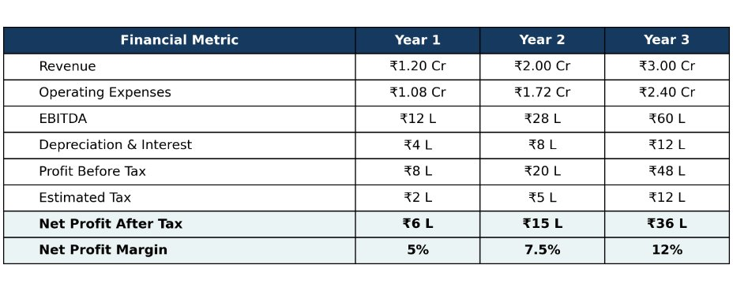
Three-Year Financial Performance

Slide 10
Financial Performance
Revenue
Year 3 Profit & Loss | ₹ lakh
Revenue | ₹300 L
Direct delivery costs | (₹126 L)
Gross profit · 58% | ₹174 L
Other operating expenses | (₹114 L)
EBITDA · 20% | ₹60 L
Depreciation and interest | (₹12 L)
Profit before tax | ₹48 L
Estimated tax | (₹12 L)
Net profit · 12% | ₹36 L
₹3.00 Cr
₹2.00 Cr
₹1.20 Cr
Year 1
Year 2
Year 3
Net profit ₹6 L → ₹15 L → ₹36 L (margin 5% → 7.5% → 12%). Growth +66.7% in Year 2, +50% in Year 3. Cumulative revenue ₹6.20 Cr.
Anvexa · Investor Pitch
9

Slide 11
Growth Strategy & Roadmap
Growth Strategy
Roadmap
Cluster-based entry. Technical account managers in Pimpri-Chinchwad; B2B sales in Pune and Mumbai.
Months 0–3
Set up financial reporting and cash controls; prioritise two repeatable offerings.
Capacity scaling. Hire 12 engineers and AI specialists.
Geographic expansion. Gujarat and Karnataka by FY2028.
Months 3–6
Productization. 40% of custom modules become repeatable vertical SaaS by FY2029.
Strengthen the Pune and Mumbai pipeline; build client case studies.
New frontier. AI, Cloud, Cybersecurity and Quantum technologies.
Months 6–12
Expand recurring contracts; track gross margin and retention.
Months 12–24
Enter Gujarat and Bengaluru only when demand, capacity and unit economics support it.
Anvexa · Investor Pitch
10

Slide 12
Investment Proposal
Use of Funds | Amount | Purpose
R&D | ₹60 L · 30% | Productise repeatable solutions; build Quantum capability
Sales & Marketing | ₹50 L · 25% | Measurable B2B pipeline in target regions
Hiring | ₹40 L · 20% | Technical and delivery staff against demand
Infrastructure | ₹20 L · 10% | Secure development, testing and cloud operations
Security & Compliance | ₹20 L · 10% | Internal controls and ISO 27001 audit readiness
Working Capital | ₹10 L · 5% | Buffer for client collection timing
Growth round
₹2 Cr
16.67% equity
Pre-money ₹10 Cr · Post-money ₹12 Cr. To strengthen AI, Cloud, Cybersecurity and Quantum readiness.
Capital is deployed against milestones, with a named owner, budget and outcome for every allocation.
Anvexa · Investor Pitch
11

Slide 13
Investor Value & Risk Management
Investor Value Proposition
Financial Risk Management
· Participation in future growth
Risks: delayed client payments, client concentration, cost overruns, cyber incidents, hiring ahead of revenue.
· Potential equity value increase if the business succeeds
· Potential dividends, if declared and sustainable
Controls: 13-week cash forecast, weekly overdue-invoice review, milestone billing, project-level margin tracking, monthly budget review, staged investment deployment.
· Periodic reporting and visibility on use of funds
· Milestone-based capital deployment
₹45 L
₹35 L
₹20 L
cash and equivalents (illustrative)
client receivables (illustrative)
existing business loans (illustrative)
Returns are not guaranteed. Terms and valuation are subject to negotiation and due diligence.
Anvexa · Investor Pitch
12

Slide 14
Conclusion
Anvexa combines a connected, secure and intelligent platform with a usage-based model that already serves 32 recurring clients profitably. ₹2 Cr of growth capital will strengthen our AI, Cloud, Cybersecurity and Quantum readiness as we keep serving India’s mid-market.
Connected by Intelligence.
Anvexa · Investor Pitch
13

